Slide 1
London Calling 2026
Saturday 16th May 2026 - 00:00-16:00 BST

Slide 2


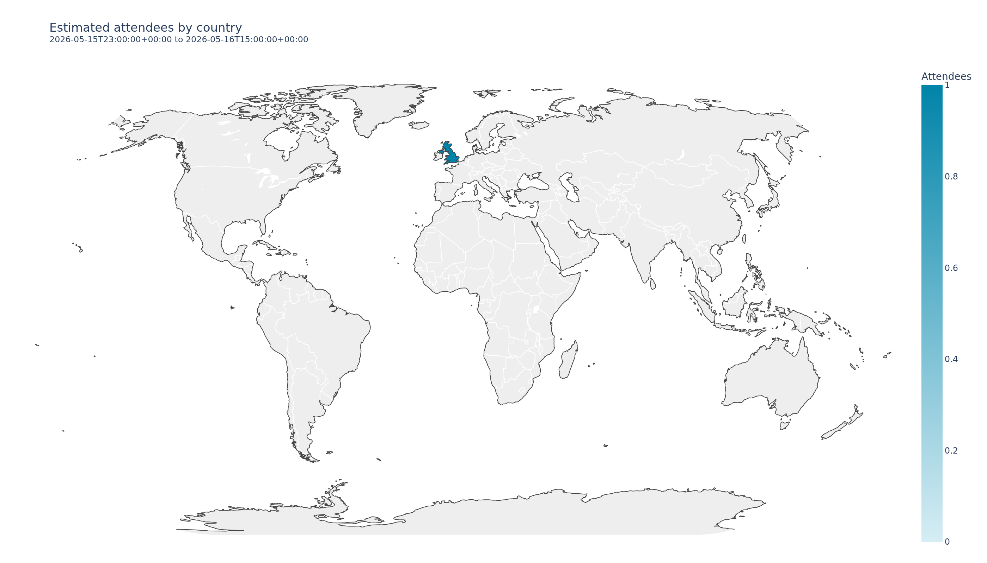

Summary online
Text summary of notable data, feedback / statistics – total views of ”Update from Oxford Nanopore Technologies"
0.0hrs
Amount of time spent on the platform by delegates – with an average duration each -0.58
0
1 attendees including Oxford Nanopore staff
0 views
1 including Oxford Nanopore staff
1
Participating countries
Top 4 countries: United Kingdom
Map to show where delegates where online delegates were based during the LC2026 live days.

Slide 3
Summary- onsite
XXX
Delegates onsite
(Get from Helen)
XXX
Participating countries
(Top 4: XXX,XXX, XXX,XXX)
N/A
Content views on the app
(webinars + posters)

Slide 4
Feedback and social media engagement
Screenshots of key tweets (Sanju to check other platforms- e.g Bluesky?)
Key quotes from online survey
Here is an overview of feedback received on DATE

